Slide 1
Semaphore-Based Traffic control System
MAHA CHAUDHARY (FA22-BCE-082)
AYESHA BUTT (FA22-BCE-053)

Slide 2
Overview
Objective:
To design a traffic control system leveraging semaphores for efficient and collision-free management of vehicular flow at intersections.
Why Semaphores?
They provide a mechanism for process synchronization, ensuring orderly access to shared resources (in this case, the intersection)

Slide 3


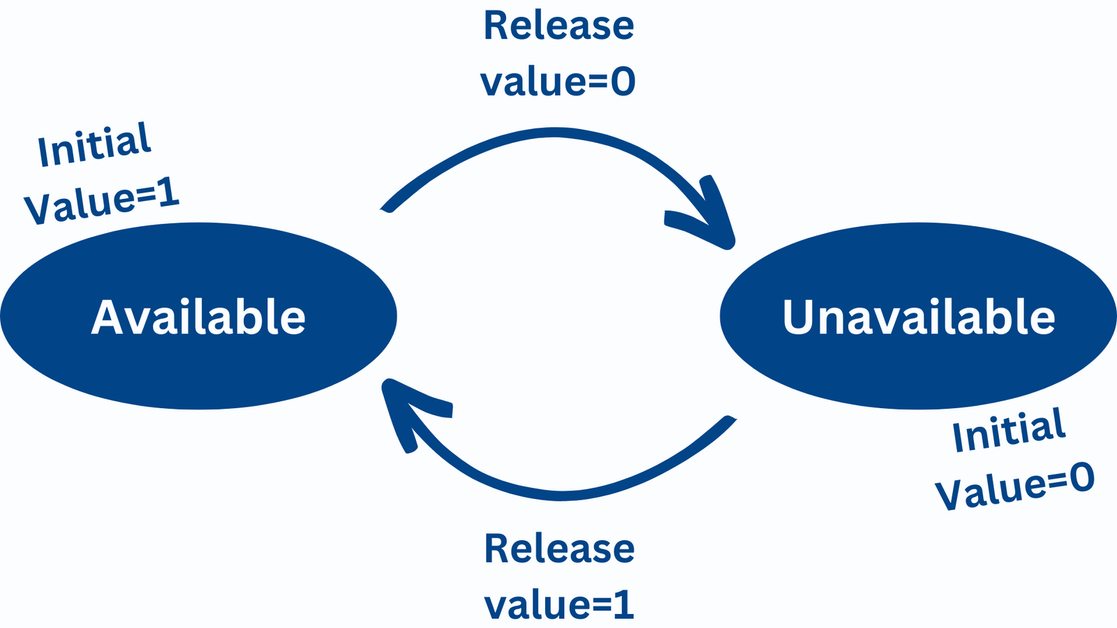

Semaphore Basics:
Definition:
A semaphore is a variable or abstract data type used to control access to a common resource.
Operations:
Wait (P): Decrements the semaphore. Blocks the process if the value becomes zero or negative.
Signal (V): Increments the semaphore. Unblocks one of the waiting processes, if any exist.

Slide 4
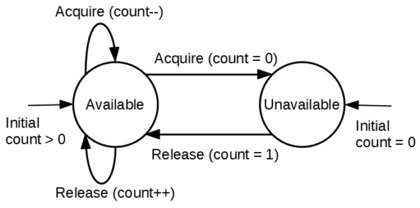
Types of Semaphores:
Binary Semaphore:
Used to ensure mutual exclusion, allows only one process/thread to access the resource at a time.
Counting Semaphore:
Can have values greater than one, allowing multiple processes to access the resource concurrently up to a specified limit

Slide 5
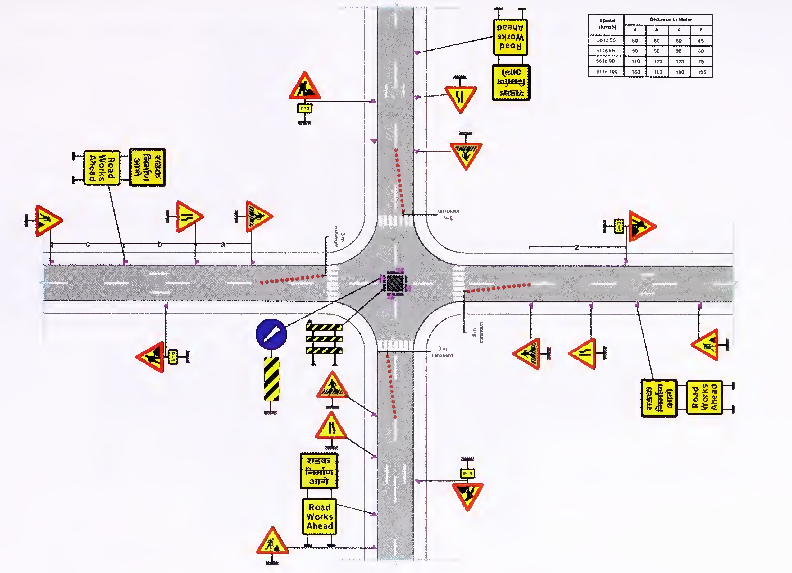
Traffic Control Requirements:
Multiple vehicles from different directions need access to the same intersection.
Prevent collisions by synchronizing the flow.
Allow adaptive behavior for dynamic traffic patterns.
Ensure fairness among all traffic directions while giving priority to emergency vehicles if necessary.
ThePhoto by PhotoAuthor is licensed under CCYYSA.

Slide 6
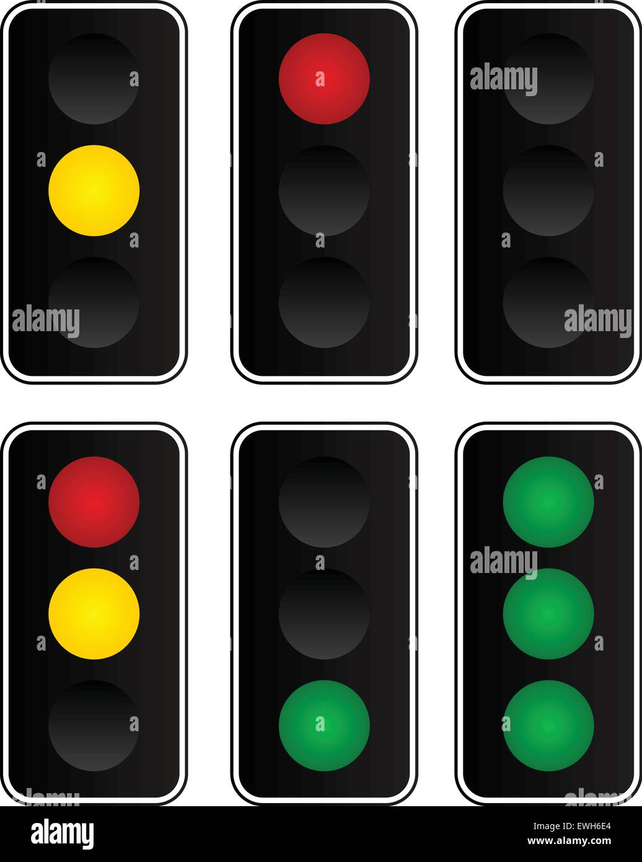
Design of the System
Core Elements:
Semaphore Variables: Represent traffic signals for each lane. For example:
N_Signal for Northbound traffic.
S_Signal for Southbound traffic.
E_Signal for Eastbound traffic.
W_Signal for Westbound traffic.
Controller: Central system responsible for managing semaphore states and handling the traffic light transitions.
Sensors (optional): Installed on lanes to detect traffic density and dynamically adjust signal durations

Slide 7
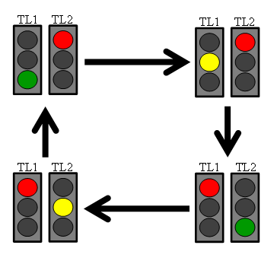
Intersection Logic:
At any given time, only one direction has the green signal (allowed to proceed).
Traffic flows are managed in cycles:
Green light for one direction.
Yellow light as a transition.
Red light for all other directions.
Duration of green light can be adjusted based on traffic density or preset timing.
Priority handling for emergency vehicles overrides the current cycle.

Slide 8
Explanation of Logic:
The control_traffic function manages the semaphore-based signal switching logic.
Each direction waits for its semaphore to be released (green light).
After the allowed green light period (delay_green_light), the control passes to the next direction by signaling its semaphore.
The cycle repeats indefinitely, ensuring a fair and orderly flow of traffic.

Slide 9

Explanation of Logic
Priority Handling:
Emergency vehicles trigger an interrupt to override the current cycle.
The controller immediately turns the light green for the emergency vehicle's direction and resumes the normal cycle afterward.
Integration with Sensors:
Traffic density sensors can dynamically adjust time_green based on real-time data.
For example:
Longer green light duration for high-traffic lanes.
Shorter duration for low-traffic lanes.

Slide 10
Advantages
Safety: Prevents simultaneous access to critical sections, reducing the risk of collisions.
Efficiency: Ensures fair and consistent traffic flow across all directions.
Flexibility: Can adapt to different intersection layouts and traffic scenarios.
Scalability: Easily extendable to multi-lane or multi-intersection systems.

Slide 11
Challenges and Countermeasure
Challenge | Countermeasure
Starvation of low-priority lanes | Implement fairness algorithms to cycle priorities
Traffic density variability | Use real-time sensor data for adaptive control
Emergency vehicle priority | Introduce pre-emption in semaphore scheduling

Slide 12
Applications
Urban Traffic Systems: Synchronizing traffic at intersections in busy city areas.
Smart Cities: Integration with IoT for real-time traffic monitoring and control.
Industrial Use: Synchronizing conveyor belts, cranes, or transport systems in factories and warehouses.

Slide 13

Conclusion
Semaphore-based traffic control provides a structured and efficient way to manage intersections. With advancements in AI, IoT, and sensor technologies, this approach can evolve into a cornerstone of intelligent traffic management systems. Its modularity and flexibility make it suitable for both simple intersections and complex urban networks.

Slide 14
References
"Operating System Concepts" by Silberschatz et al.
Research on adaptive traffic management systems.
Real-world applications of semaphores in embedded systems.

